Slide 1

Social Broadcast
Prepared by Petrov Valery, 11-603
github.com/valera0798/ITISInformatics/projects/WebAppProject

Slide 2
Problems
Merge topics were studied during the term in a one project.
Follow basics of application design principles.
Create appearance as attractive as possible.

Slide 3
Solution
Social network where users communicate by sending messages to global wall.
Suitable
* Many ways to use technologies
Simplicity
* Use cases are natural
Design freedom
* No limits for project theme

Slide 4
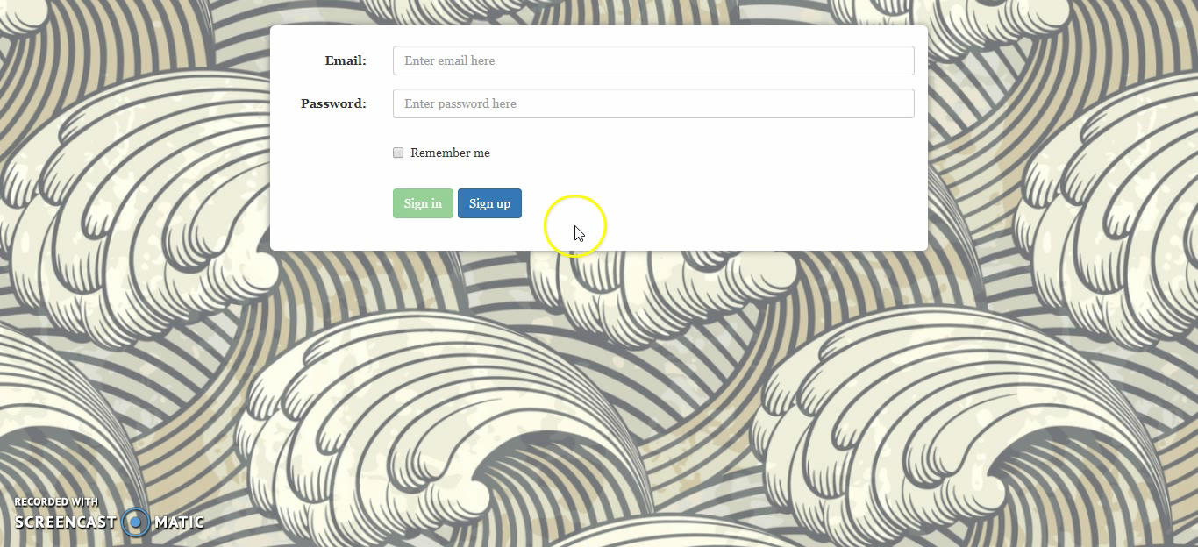

Slide 5







Front end
Middleware
Back end
Servlet API
GSON
Notify.js
JSTL

Slide 6
Profit
Practice of recently studied material and old knowledge.
New skills were gotten in a new area such as web programming.
Personal qualities were improved during the work.

Slide 7
Thank you for attention.
github.com/valera0798/ITISInformatics/projects/WebAppProject

